Slide 1





Erasmus Medal 2025

Slide 2
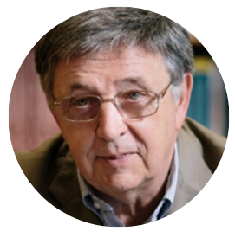
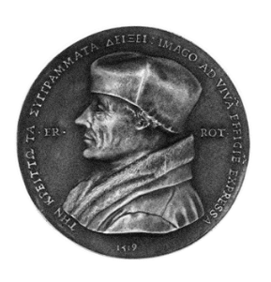

Erasmus Medal 2025
The trustees of Academia Europaea are honoured to award the Erasmus Medal to Mathematician
László Lovász MAE
The Erasmus Medal of Academia Europaea is awarded to a member who has maintained over a sustained period, the highest level of international scholarship and recognition by peers.
Chair: Paolo Papale MAE, Class Chair and Honorary Vice president
Laudation: Janos Pach MAE

Slide 3
Erasmus Medal 2025
CITATION [short]
László Lovász is a towering mathematician of our age. He has been a defining force in discrete mathematics and computer science over the past 60 years. His influence has decisively contributed to the general appeal and expansion of these fields and their closer integration with more classical areas of pure and applied mathematics. He solved a long list of major open problems, each time tackling the problem with powerful new techniques of which the significance went far beyond their original target. He is arguably the most influential theory builder of discrete mathematics. In particular, he has been one of the pioneers of the interplay between computer science, discrete and continuous mathematics, a master at establishing unexpected connections between seemingly distant fields. His invariably elegant and powerful ideas have spawned new subfields in many areas.
See full document for further information

Slide 4

Laudation to be given by Professor Janos Pach
Pach is Professor of Combinatorial Geometry at Rényi Institute of Mathematics (Budapest) & EPFL (Lausanne) – see https://www.ae-info.org/ae/Member/Pach_J%C3%A1nos
His main fields of interest are discrete and computational geometry, convexity, and combinatorics. He wrote more than 350 research papers. His books, “Research Problems in Discrete Geometry” (with Brass and Moser) and “Combinatorial Geometry” (with Agarwal) were translated into Japanese, Russian, and Chinese. He is co-editor-in-chief of Discrete & Computational Geometry. He received the Lester Ford Award from the Mathematical Association of America (1990), the Rényi Prize and the Academy Award from the Hungarian Academy of Sciences (1993, 1998), the Szele Prize from the Bolyai Mathematical Society (2019). He was elected ACM Fellow (2011), AMS Fellow (2015), member of Academia Europaea (2014) and the Hungarian Academy of Sciences (2022).

Slide 5
2025 AE-Heinz Nixdorf Erasmus Lecture
THE BEAUTY OF MATHEMATICS
Short Abstract:
For most people, there is probably nothing farther from being beautiful than mathematics. But for most mathematicians, beauty is probably the most important feature of really good mathematics. Just like to appreciate the beauty of modern art or music, one has to be able to look beyond the particular results, and learn to enjoy the abstract beauty, where unexpected interactions between seemingly very distant subfields pop up, beautiful geometric pictures are produced, or even applications to the real world have their aesthetics.

Slide 6


